Slide 1

Extreme Weather Events and Their Impact on Temperature in Climate Projections (2006–2080)
EART60702
Esteban Guerrero - Huabin Ye - Zhihao Xu

Slide 2

Climate change is increasing the frequency and intensity of extreme weather events.
Understanding future trends in heatwaves, precipitation, and wind extremes is crucial for climate adaptation.
Notes:
Extreme weather events, including heavy precipitation, snowfall, and extreme heat, pose significant challenges to societies worldwide. In the UK, understanding the driving factors behind such events is particularly crucial due to their profound impacts on infrastructure, agriculture, public safety, and energy demand. Studies have shown that extreme weather events significantly affect public health and mental well-being, with flooding and heatwaves contributing to increased cases of anxiety, depression, and PTSD (Cruz et al., 2020). Additionally, extreme precipitation events have been linked to widespread flooding, emphasizing the need for improved forecasting and mitigation strategies (Darwish et al., 2020).
Recent advancements in climate modeling have provided critical insights into the projected changes in urban heat islands (UHIs) and extreme precipitation under climate change. For instance, Lo et al. (2020) utilized the UKCP18-regional climate projections to analyze summer daytime and nighttime UHI trends in England's 10 most populous cities. Their findings revealed divergent patterns: nighttime UHI intensities, linked to TREFMXAV_U and TREFHT, are projected to increase due to greater thermal inertia in urban areas, while daytime UHI intensities decrease in most cities, associated with reduced FSNS and FLNS under drying conditions.
The atmospheric drivers of extreme precipitation have also been investigated. Allan et al. (2016) analyzed daily extreme rainfall events over the UK using blended satellite-gauge data and climate model simulations, identifying distinct seasonal and regional mechanisms. Winter extremes are strongly tied to atmospheric rivers (ARs), which associated with increased QBOT values and vapor transport. These AR-driven events often lead to widespread flooding due to orographic enhancement and sustained moisture convergence. In contrast, summer extremes in southeastern England are linked to localized convection and easterly flows from the North Sea, characterized by higher QBOT levels but weaker synoptic-scale transport (Allan et al., 2016).

Slide 3
How do extreme weather events (heatwaves, heavy precipitation, strong winds) evolve over time in climate projections from 2006 to 2080, and how do they impact temperature levels?

Slide 4
To address this question, we utilized a climate projection dataset from the Community Earth System Model (CESM), encompassing 27,374 records spanning from 2006 to 2080.
Attributes
Location
I. Temporal/Spatial: Time: Time of observation/measurement Latitude (lat): Latitude of the location (units to be specified - likely degrees) Longitude (lon): Longitude of the location (units to be specified - likely degrees) II. Temperature: TREFMXAV_U: Urban daily maximum of the average 2-meter air temperature (K) TREFHT: Reference height temperature (K) III. Wind: UBOT: Zonal wind component at the lowest model level (m/s) VBOT: Meridional wind component at the lowest model level (m/s) IV. Precipitation: PRECT: Total precipitation rate (m/s) PRSN: (Undocumented - Potential snowfall/snow precipitation rate. V. Flux and Humidity: FLNS: Net longwave flux at the surface (W/m²) FSNS: Net Shortwave Flux at the Surface (W/m²) QBOT: Water vapor mixing ratio at the lowest model level ( kg/kg )
Based on the latitude and longitude attributes (53.246075, 357.5), we identified a unique location within the dataset, in Norwich, UK.
Data Preparation
Generated month and decade columns to facilitate temporal analysis.
Generated columns with temperature in °C
Wind speed was calculated using the L2 norm of the relevant wind vector components.

Slide 5




What is an Extreme Weather Event?
Based on the literature, we have defined a reference period for the analysis: 2006 to 2016, which serves as a reference for analysing extreme events in each decade.
Extreme events are identified based on values that exceed certain percentiles within this base period.
HT95
Warm Days
LT05
Cold Days
R95
Precipitation Extremes
W95
Wind Extremes
Days (per year /season/ month) with a site-specific threshold, calculated as the calendar-day 95th percentile of the daily temperature distribution in the baseline period.
Days (per year/ season/ month) with temperatures below a site-specific threshold, calculated as the calendar-day 5th percentile of the daily temperature distribution in the baseline period.
Days (per year/season/month) with precipitation amounts exceeding a site-specific threshold for moderate and very wet days, calculated as the 95th percentile of the daily precipitation distribution in the baseline period.
Days (per year /season /month) with wind speeds exceeding a site-specific threshold for moderate and very windy days, calculated as the 95th percentile of the daily wind speed distribution in the baseline period.

Slide 6
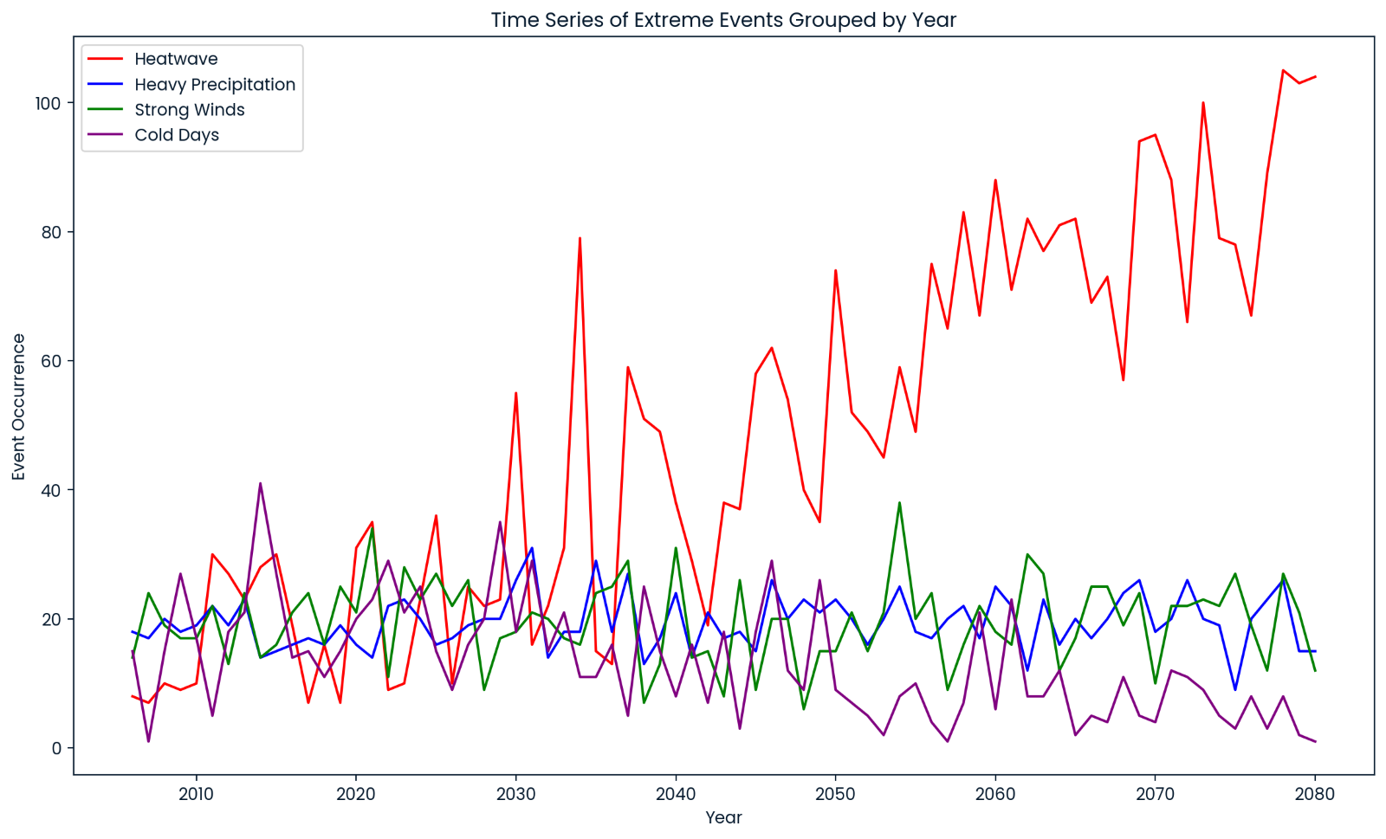
Our analysis of the event time series indicates a projected significant increase in the frequency of heatwaves.
Extreme precipitation and wind events are expected to remain relatively constant over the next few decades, unlike warm and cold events, which tend to vary significantly.

Slide 7
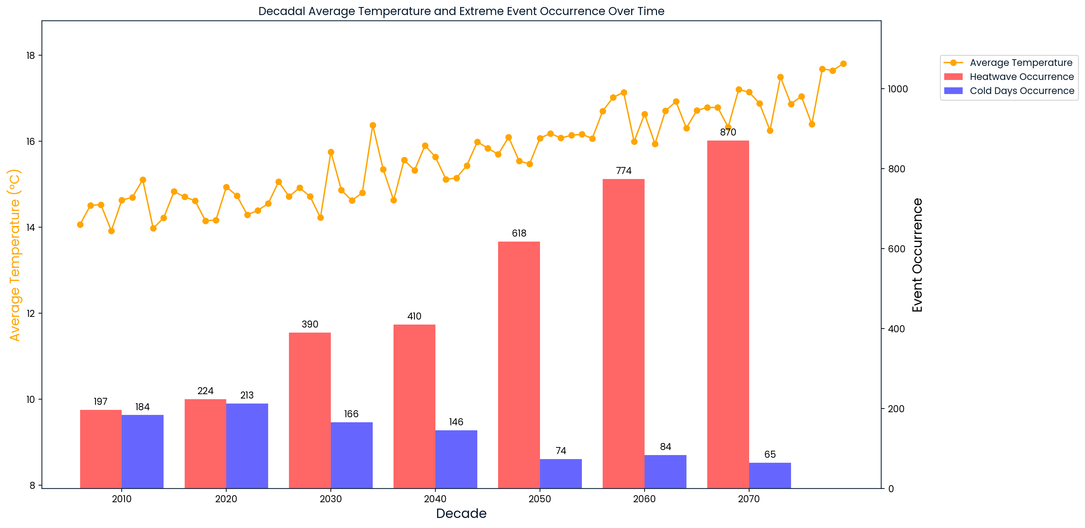
By 2080, extreme heat events are expected to increase by at least 4.4 times compared to the 2010s and average maximum temperatures are expected to increase by at least 25%.
The analysis reveals a projected increase in warm days and a decrease in cold days.

Slide 8
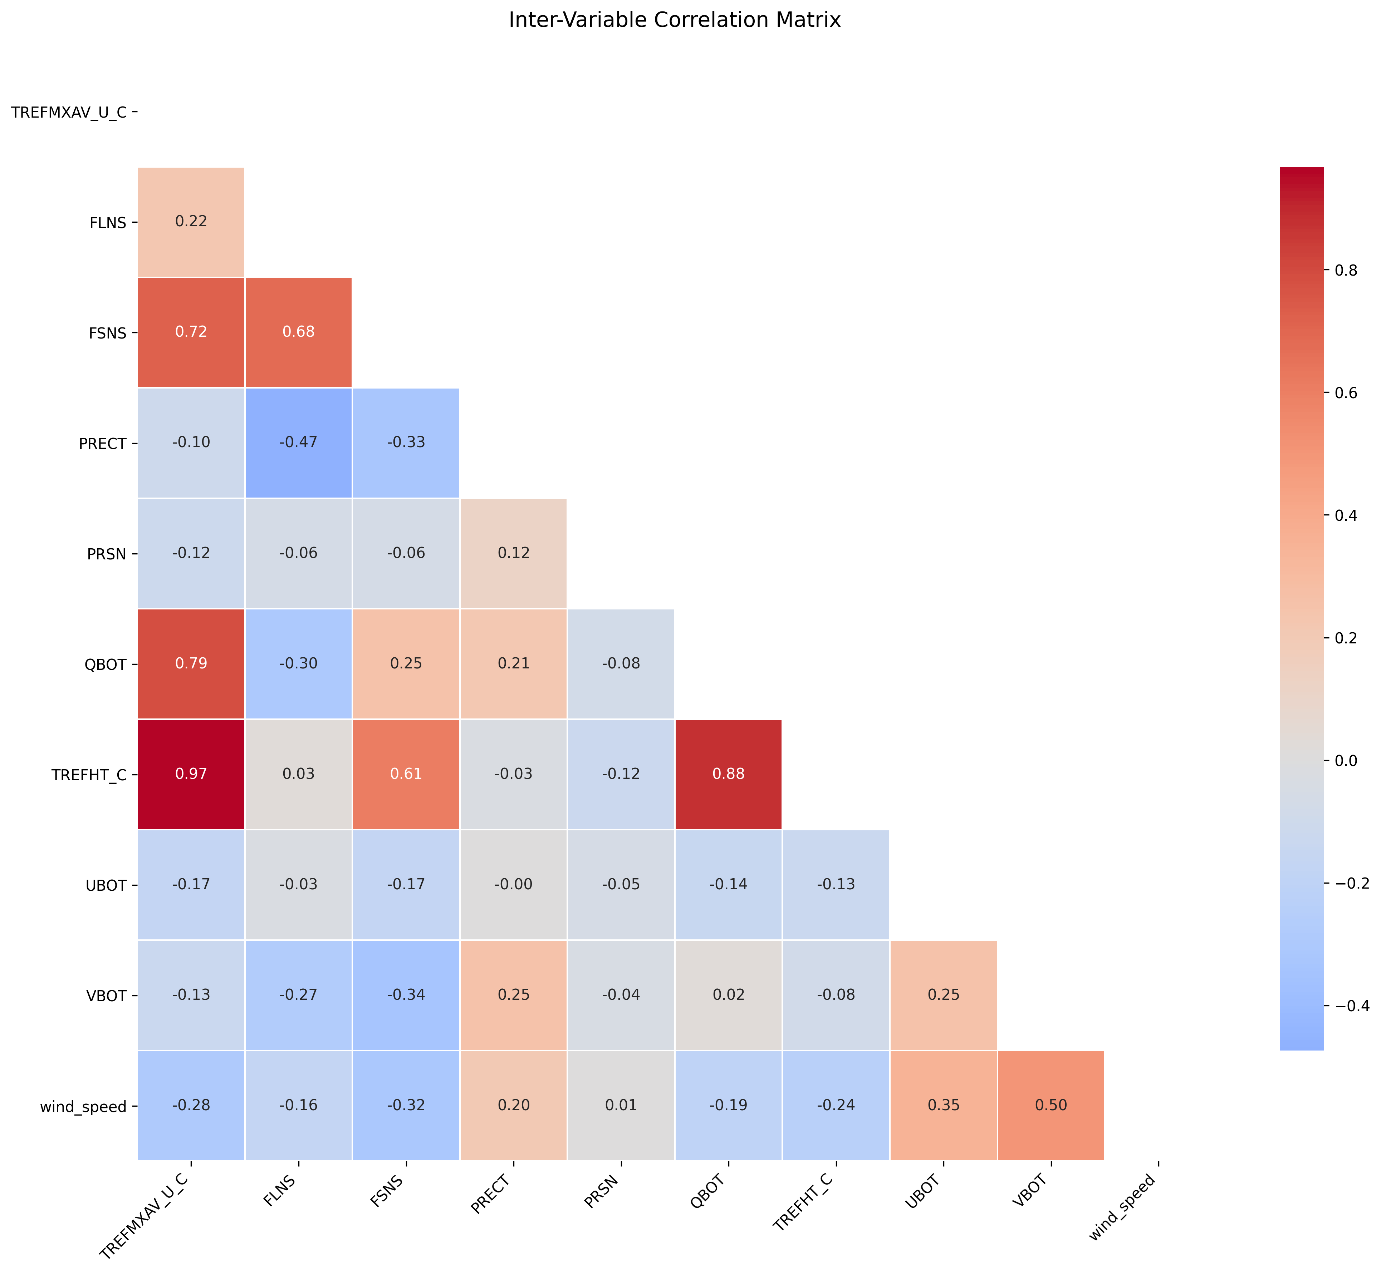
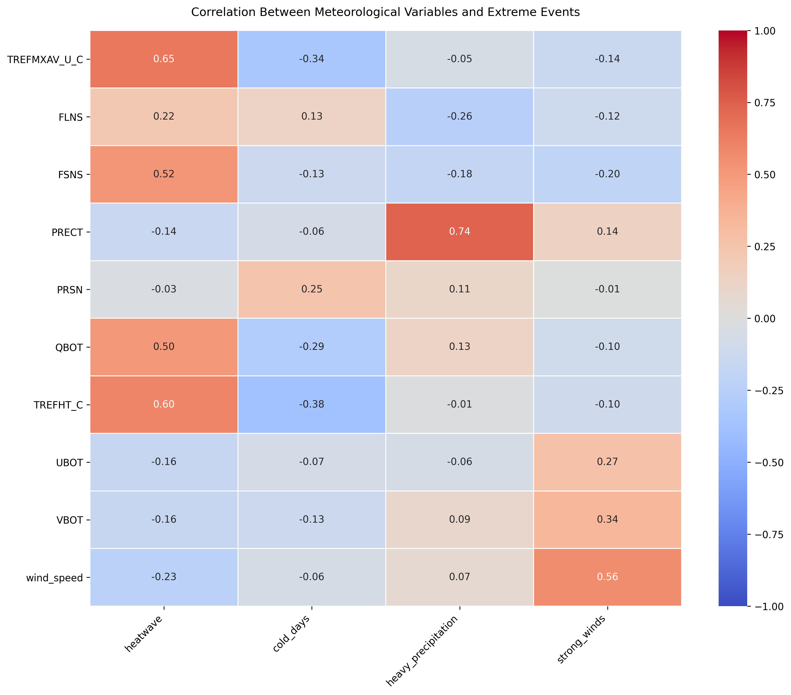
To better understand the relationships between various variables and extreme weather events, we calculate point-biserial correlation coefficients.
Solar flux and humidity strongly influence temperature extremes (heatwaves, cold days), while humidity fuels heavy rain. Wind patterns show complex, often indirect, relationships.
Notes:
To better understand the relationships between various variables and extreme weather events, we calculate point-biserial correlation coefficients.
Solar flux and humidity strongly influence temperature extremes (heatwaves, cold days), while heavy rain is mainly connected with humidity .
Wind patterns show complex, often indirect, relationships.

Slide 9
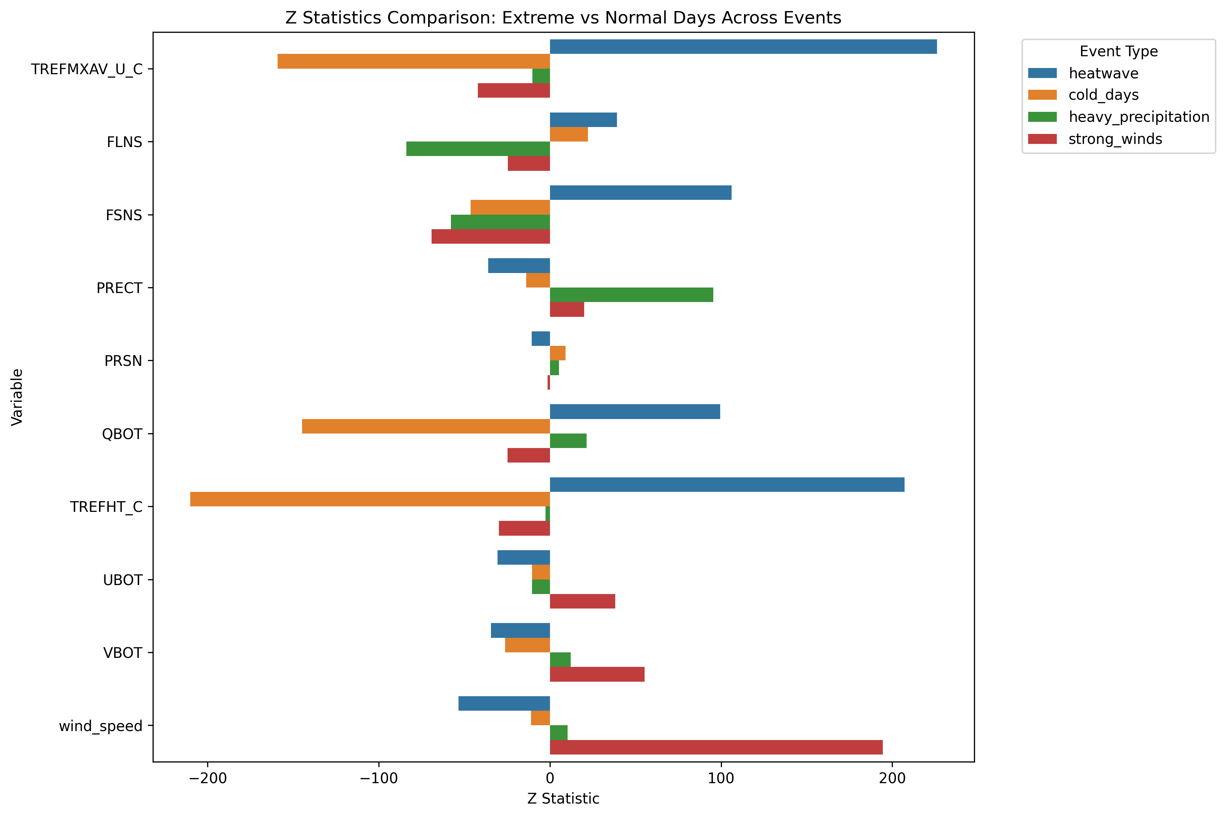
High Z-statistics and near-zero p-values indicate significant differences in variable averages between extreme events and normal days.
Most relationships in the correlation matrix and point-biserial correlation results are aligned with Z-test.
FLNS has positive Z-scores in both heatwaves and cold days
strong positive correlation with temperature.
Notes:
To identify key drivers of extreme weather, we performed Z-tests to validate differences in variables between extreme events and normal days.
High Z-statistics and near-zero p-values indicate significant differences in variable averages.
And we found most relationships in the correlation matrix and point-biserial correlation results are aligned with Z-test.
Except longwave radiation, it maintains a strong positive correlation with temperature. But it intensifies both extreme heatwaves and cold days.
So we think Further research is needed to clarify its role and interactions.

Slide 10
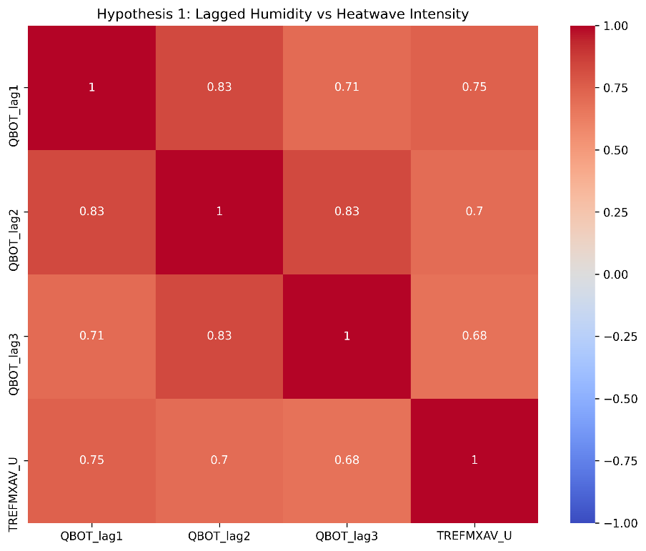
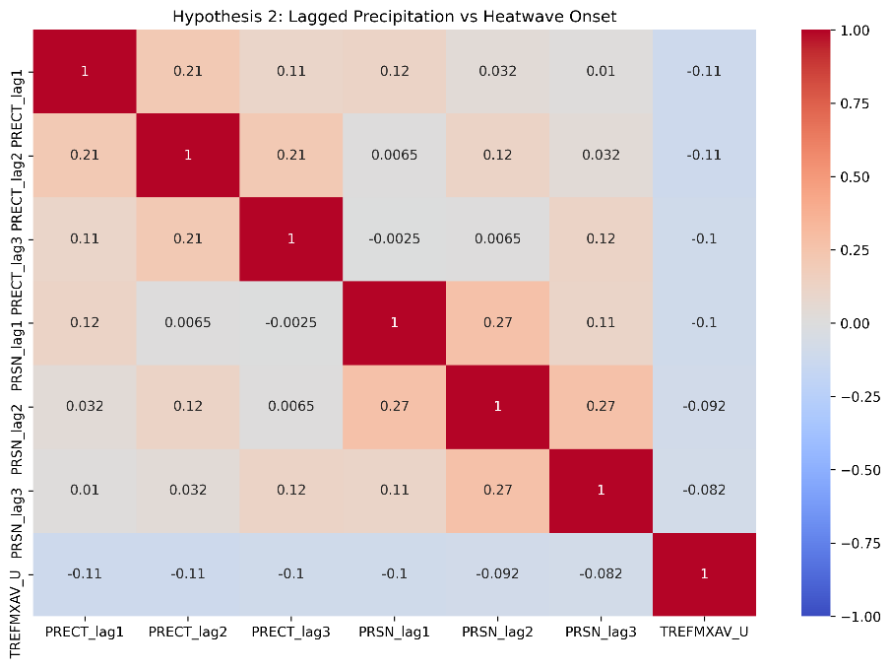
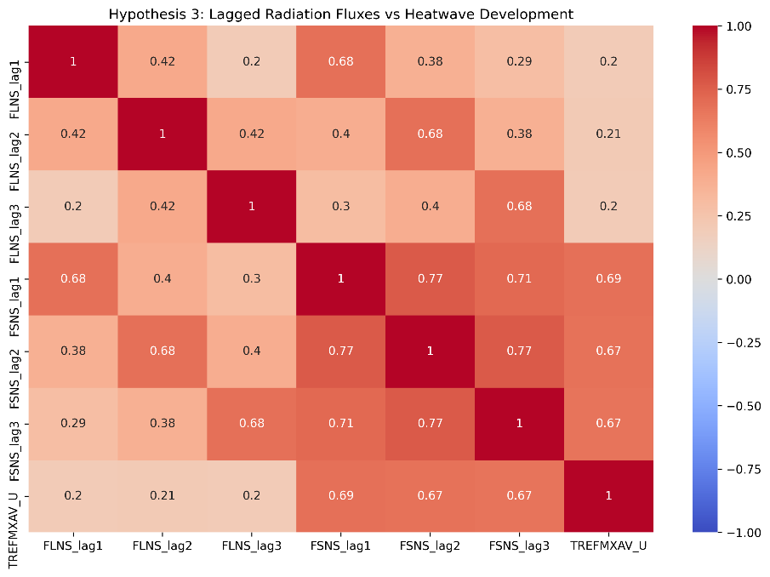
Lag Effects on Heatwave Development
Key Drivers from Humidity, Precipitation & Radiation
Humidity in past days has a strong link (0.7–0.8) to heatwaves.
Less rain/snow in past days shows only a tiny link (-0.1 to -0.02) to heatwaves.
Strong sunlight days before → bigger heatwaves (link: ~0.8).
Notes:
As heatwaves are expected to increase rapidly, Then we explore three key drivers of heatwaves using lagged correlations.
When it’s humid for several days in a row, heatwaves get stronger. Less rain before a heatwave might make it slightly worse, but the connection is tiny. Strong sun in previous days is a clear warning sign – it’s linked to heatwaves with a score of 0.8.

Slide 11

Conclusions & Implications
The frequency and intensity of extreme events are expected to rise, potentially leading to more frequent and severe heat stress.
Heatwaves show dramatic rising trends, especially in later decades (2050–2080).
High humidity and radiation flux are strongly correlated with the occurrence of temperature extremes and can serve as early warning signals.

Slide 12
Future Work
Validate findings using historical climate data to compare projected trends with past observations and assess the reliability of the projections.
Expand the analysis to other regions in the UK to identify spatial patterns and regional differences in extreme weather events and their temperature impacts.
Develop machine learning models to predict extreme weather events . Use predictive algorithms to identify early warning signs of extreme heat, storms, or heavy rainfall, improving preparedness and response strategies.

Slide 13
References
Klein Tank, A., & Können, G. (2003). Trends in indices of daily temperature and precipitation extremes in Europe, 1946–99. Journal of Climate, 16(22), 3665–3680.
Roldán-Gómez, P. J., De Luca, P., Bernardello, R., & Donat, M. G. (2025). Regional irreversibility of mean and extreme surface air temperature and precipitation in CMIP6 overshoot scenarios associated with interhemispheric temperature asymmetries. Earth System Dynamics, 16(1), 1–27.
Seneviratne, S. I., Zhang, X., Adnan, M., Badi, W., Dereczynski, C., Di Luca, A., Ghosh, S., Iskandar, I., Kossin, J., Lewis, S., Otto, F., Pinto, I., Satoh, M., Vicente-Serrano, S. M., Wehner, M., & Zhou, B. (2021). Weather and climate extreme events in a changing climate. In V. Masson-Delmotte, P. Zhai, A. Pirani, S. L. Connors, C. Péan, S. Berger, N. Caud, Y. Chen, L. Goldfarb, M. I. Gomis, M. Huang, K. Leitzell, E. Lonnoy, J. B. R. Matthews, T. K. Maycock, T. Waterfield, O. Yelekçi, R. Yu, & B. Zhou (Eds.), Climate change 2021: The physical science basis. Contribution of Working Group I to the Sixth Assessment Report of the Intergovernmental Panel on Climate Change (pp. 1513–1766). Cambridge University Press.
Walsh, J. E., Ballinger, T. J., Euskirchen, E. S., Hanna, E., Mård, J., Overland, J. E., Tangen, H., & Vihma, T. (2020). Extreme weather and climate events in northern areas: A review. Earth-Science Reviews, 209, 103324.
Smith, C. and Lawson, N. (2012), Identifying extreme event climate thresholds for greater Manchester, UK: examining the past to prepare for the future. Met. Apps, 19: 26-35. https://doi.org/10.1002/met.252

